Slide 1




CSC4202 - DESIGN ALGORITHM AND ANALYSIS
GROUP PROJECT
Prepared by:
MUHAMMAD SHAKIR IQBAL BIN SAMRI 210362
MUHAMMAD ARIF BIN ZULKEPLI 210079
AHMAD HAZIQ BIN SUZAKI 209922

Slide 2
Problem statement
Importance of AAD
TABLE OF CONTENTS
Why finding optimal solution is important
Algorithm suitability
Flowchart & code
Algorithm Complexity
Output

Slide 3
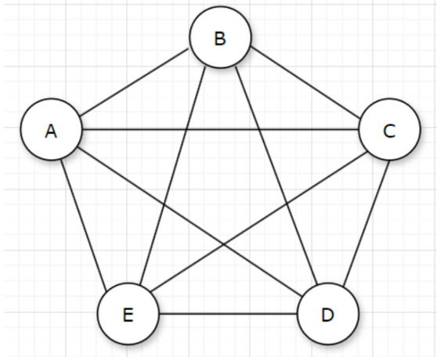
PROBLEM STATEMENT
Finding the perfect rental house is a common challenge for students especially when there are numerous options available in a given area. A student is looking for a rental house near a university, such as in the Seri Kembangan area which has many housing options. The distance between these houses can make it difficult for students to decide where to start their search of different houses.
The goal is to find the minimum travel time to survey all possible rental houses from the student's starting point location.

Slide 4
Optimal Solutions
Precision: AAD ensures that the solutions are feasible and optimal.
Resource Optimization: Optimal solutions minimize resource usage, such as time, money, and energy, which are crucial for students.
IMPORTANCE OF ADVANCE ALGORITHM DESIGN (AAD)
Performance
Speed: Advanced algorithms are designed to be computationally efficient to reduce the time complexity of solving problems.
Memory Usage: Efficient algorithms manage memory usage effectively ensuring that even with large datasets, the system does not run into memory overflow issues.

Slide 5
Time Efficiency
Students often have limited time due to their academic commitments. An optimal solution helps them quickly identify the best housing options without spending excessive time on viewings.
WHY FINDING OPTIMAL SOLUTION IS IMPORTANT
Cost-Effectiveness
Traveling shorter distances reduces the cost associated with transportation (fuel for a car). This is particularly important for students who often have tight budgets.
Comprehensive Comparison
An optimized travel plan ensures that students can survey all potential rental houses efficiently, providing a comprehensive comparison of rental prices, features, and locations. This thorough evaluation helps in making an informed decision and avoid oversights.

Slide 6
ALGORITHM SUITABLILITY
Algorithm | Suitability | Strengths | Weaknesses
Sorting | Not suitable | Efficient for organizing data | Does not address the specific needs of optimization problems like TSP
Divide and Conquer | Not suitable | Breaks problems into manageable sub-problems | Not effective for TSP as it does not leverage specific properties of the problem
Dynamic Programming | Suitable | Optimal solution for small to medium-sized instances, efficient for TSP | High space complexity, exponential time complexity for large instances
Greedy | Suitable (approximations) | Simple to implement, fast execution time for large instances, works well for sparse graphs | May not produce optimal solutions, susceptible to local optima, doesn't guarantee the shortest tour
Graph Algorithms | Suitable | Various algorithms available (e.g., Christofides), can find optimal or approximate solutions | Complexity depends on specific algorithm used, may require significant computational resources

Slide 7
CHOSEN ALGORITHM
Held-Karp Algorithm (Dynamic Programming)
Optimality and Exact Solutions
Dynamic Programming Advantages
Guaranteed Optimal Solution
Efficient Use of Subproblem Solutions
Systematic Exploration of All Possibilities
Held-Karp algorithm guarantees finding the optimal solution to the TSP. This is crucial for applications where exact solutions are required and suboptimal solutions could lead to significant issues.
Solve subproblems efficiently. By breaking the TSP into smaller subproblems and storing (memoizing) their solutions, it avoids redundant calculations and reduces the overall computational effort.
explores all possible routes by considering each subset of houses and their permutations. This comprehensive approach ensures that no potential optimal route is overlooked.

Slide 8
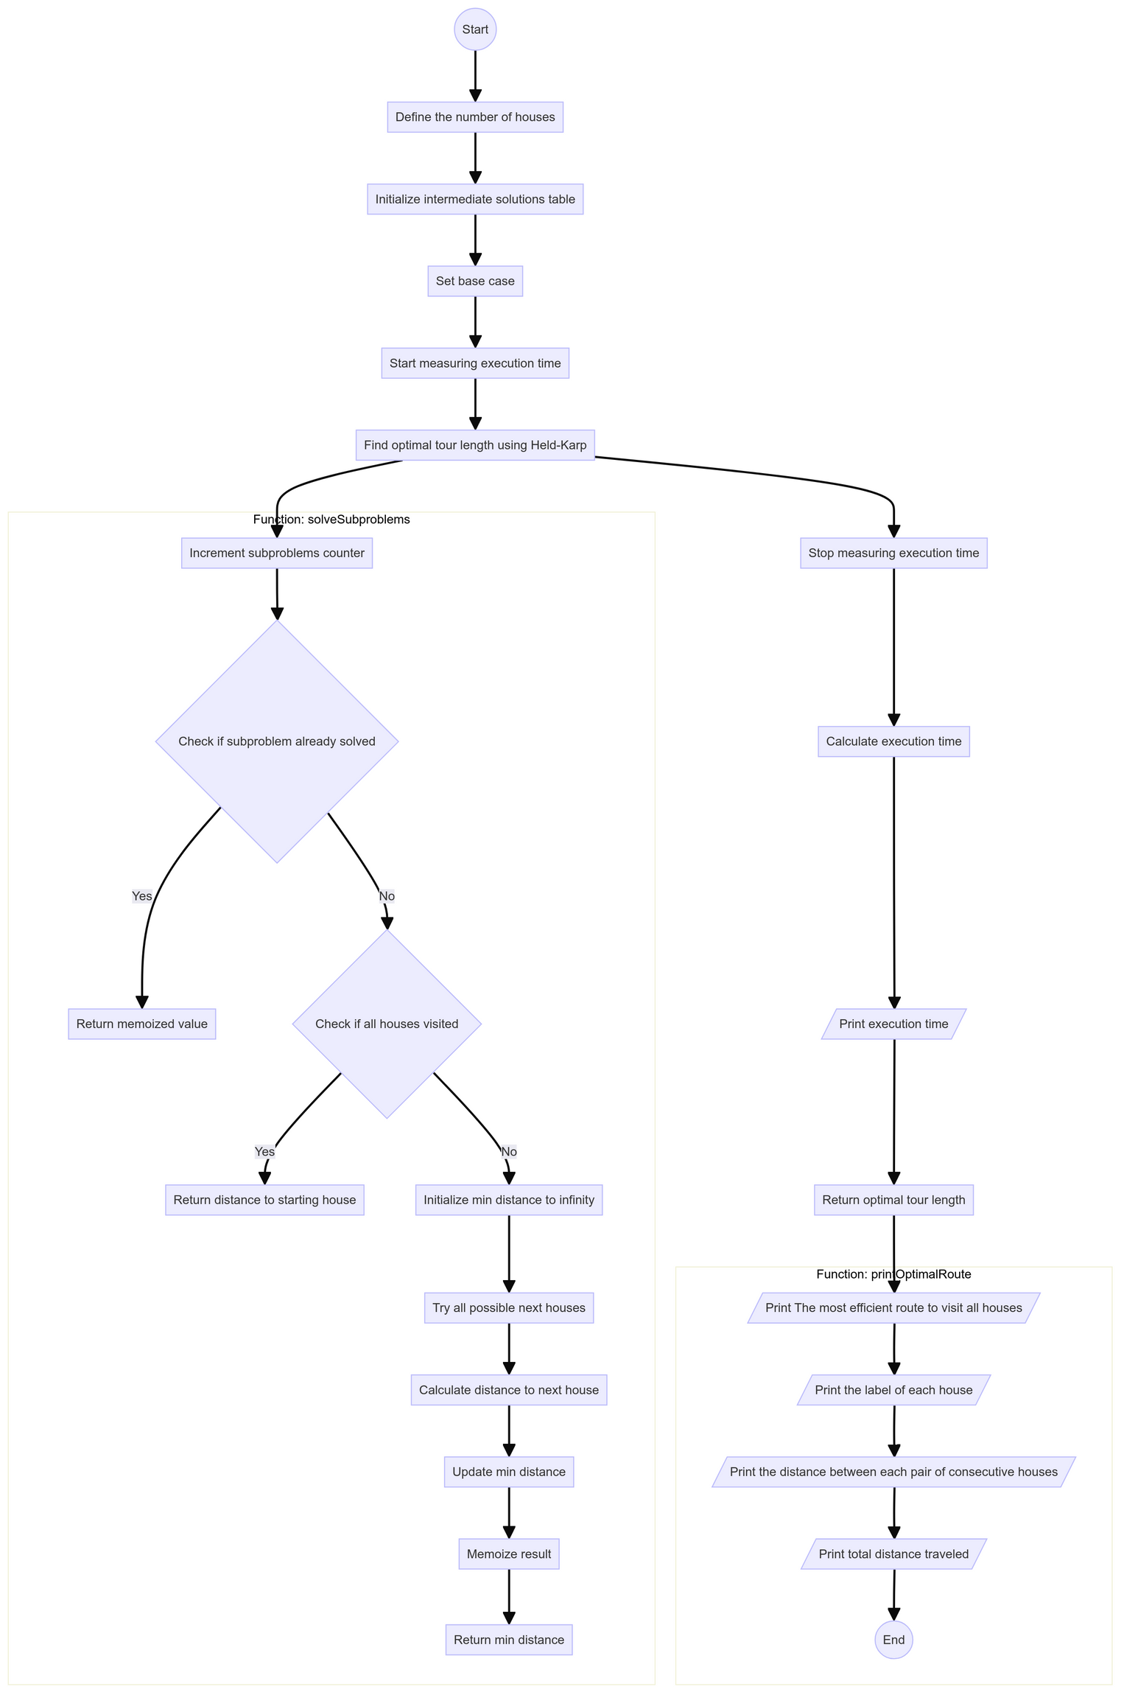
FLOWCHART

Slide 9
CODE
Code in java langguage

Slide 10

import java.util.Arrays;
public class TravelingSalesmanProblem5 {
// Number of houses
static int V = 5;
// Define infinity as a large enough value
static int INF = Integer.MAX_VALUE;
// Counter to keep track of the number of possible routes considered
static int routesConsidered = 0;
// Solves the Traveling Salesman Problem (TSP) using the Dynamic Programming-based Held-Karp algorithm
public static int[][] tspHeldKarp(int[][] graph) {
// Create a memoization table for subproblem solutions
int[][] memo = new int[V][(1 << V)];
for (int[] row : memo) {
Arrays.fill(row, -1);
}
// Initialize base case: distance from starting house to itself is 0
memo[0][1] = 0;
// Record the start time in nanoseconds
long startTime = System.nanoTime();
CODE
BASE CASE INITIALIZATION

Slide 11
// Solve subproblems and compute optimal tour length
int optimalTourLength = heldKarp(0, (1 << V) - 1, graph, memo);
// Reconstruct the optimal tour
int[] tour = new int[V + 1];
int currentHouse = 0;
int state = (1 << V) - 1;
int index = 1; // Starting from index 1 to insert house A (0)
tour[0] = 0; // House A (0) at the beginning of the tour
while (state != 0) {
int nextHouse = -1;
for (int house = 0; house < V; house++) {
if ((state & (1 << house)) != 0 && (nextHouse == -1 || memo[currentHouse][state] - graph[currentHouse][house] == memo[house][state ^ (1 << house)])) {
nextHouse = house;
}
}
tour[index++] = nextHouse;
state ^= (1 << nextHouse);
currentHouse = nextHouse;
}
// Record the end time in nanoseconds
long endTime = System.nanoTime();
CODE
RECURSIVE SUBPROBLEMS
OPTIMAL TOUR RECONSTRUCTION

Slide 12
CODE
// Print the total number of possible routes considered
System.out.println("Total number of possible routes considered: " + routesConsidered);
// Calculate the execution time in milliseconds with three decimal places
double executionTime = (double) (endTime - startTime) / 1_000_000.0;
// Print the execution time in milliseconds
System.out.println("Execution time: " + String.format("%.3f", executionTime) + " milliseconds");
// Return both optimal tour length and tour sequence
return new int[][]{{optimalTourLength}, tour};
}
// Recursive function for solving subproblems in the Held-Karp algorithm
public static int heldKarp(int currentHouse, int state, int[][] graph, int[][] memo) {
// Increment the counter for each subproblem solved
routesConsidered++;
// If the subproblem has already been solved, return the memoized value
if (memo[currentHouse][state] != -1) {
return memo[currentHouse][state];
}

Slide 13
// Base case: all houses have been visited
if (state == 0) {
return graph[currentHouse][0];
}
int minDistance = INF;
// Iterate over all possible next houses
for (int nextHouse = 0; nextHouse < V; nextHouse++) {
// If the next house has not been visited
if ((state & (1 << nextHouse)) != 0) {
int distance = graph[currentHouse][nextHouse] + heldKarp(nextHouse, state ^ (1 << nextHouse), graph, memo);
minDistance = Math.min(minDistance, distance);
}
}
// Memoize the result
memo[currentHouse][state] = minDistance;
return minDistance;
}
// Prints the most efficient route to visit all houses
public static void printHouseRoute(int[][] routeAndTime, int[][] graph) {
int optimalTourLength = routeAndTime[0][0];
int[] route = Arrays.copyOfRange(routeAndTime[1], 0, V + 1);
CODE

Slide 14
CODE
System.out.println("The most efficient route to visit all houses:");
for (int i = 0; i < V; i++) {
System.out.print(getLocationLabel(route[i]) + " ");
}
System.out.println(getLocationLabel(route[V]) + " ");
System.out.println("The Value Of Each house Travel Time");
for (int i = 0; i < V; i++) {
System.out.println(getLocationLabel(route[i]) + "-" + graph[route[i]][route[i + 1]]);
}
System.out.println("Total time traveled: " + optimalTourLength);
}
// Returns the location label corresponding to the house index
public static char getLocationLabel(int houseIndex) {
return (char) ('A' + houseIndex);
}
// Returns the value of the location intersection
public static int getLocationIntersection(int house1, int house2, int[][] graph) {
return graph[house1][house2];
}

Slide 15
CODE
// Driver's code
public static void main(String[] args) {
// House distances (example distances)
int[][] houseTravelTime = {
{0, 30, 15, 22, 12},
{30, 0, 25, 24, 10},
{15, 25, 0, 28, 13},
{22, 24, 28, 0, 8},
{12, 10, 13, 8, 0}
};
// Find the most efficient route and calculate total time traveled
int[][] routeAndTime = tspHeldKarp(houseTravelTime);
// Print the most efficient route and total time traveled
printHouseRoute(routeAndTime, houseTravelTime);
}
}

Slide 16
OUTPUT
The print-screen of program Java output in Eclipse IDE
& the result after the program run.

Slide 17
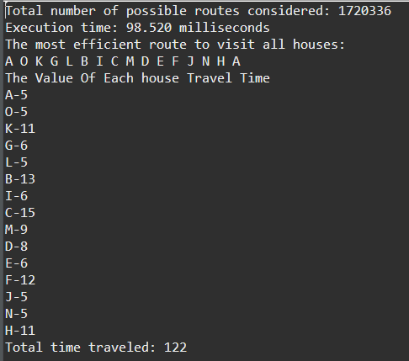
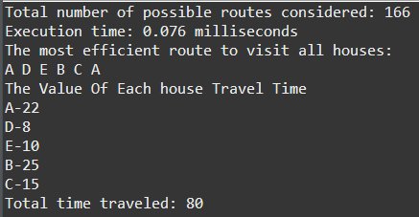
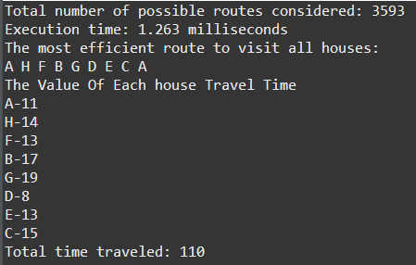
OUTPUT PRINT-SCREEN
5 HOUSES
8 HOUSES
15 HOUSES

Slide 18
OUTPUT
Total number of possible routes considered: 1720336
Execution time: 98.520 ms
The most efficient route to visit all houses: A O K G L B I C M D E F J N H A
The Value Of Each house Travel Time A-5 O-5 K-11 G-6 L-5 B-13 I-6 C-15 M-9 D-8 E-6 F-12 J-5 N-5 H-11
Total time traveled: 122
Total number of possible routes considered: 3593
Execution time: 1.263 ms
The most efficient route to visit all houses: A H F B G D E C A
The Value Of Each house Travel Time A-11 H-14 F-13 B-17 G-19 D-8 E-13 C-15
Total time traveled: 110
Total number of possible routes considered: 166
Execution time: 0.076 ms
The most efficient route to visit all houses: A D E B C A
The Value Of Each house Travel Time A-22 D-8 E-10 B-25 C-15
Total time traveled: 80
5 HOUSES
8 HOUSES
15 HOUSES

Slide 19
ANALYSIS
In this part, the discusion of analysis of the Algorithm’s Correctness and Time Complexity will be explore

Slide 20
CORRECTNESS ASPECTS
BASE CASE INITIALIZATION
1
The algorithm initializes the base case where the distance from the starting house (house A) to itself is 0.
Correctly handled by the line memo[0][1] = 0;.
RECURSIVE SUBPROBLEMS
2
heldKarp solves subproblems by considering all possible next houses and memoizes the results to avoid redundant computations.
the minimum distance is correctly computed by combining solutions to subproblems.
OPTIMAL TOUR RECONSTRUCTION
3
After computing the optimal tour length, the algorithm reconstructs the optimal tour by backtracking through the memoization table,
to ensuring the correct sequence of houses is visited.

Slide 21
TIME COMPLEXITY ANALYSIS
The Held-Karp algorithm for TSP has a time complexity of O(n^2 . 2^n), where n is the number of houses.
MEMOIZATION TABLE
1
The memoization table has dimensions n x 2^n, resulting in O(n . 2^n) space complexity.
SUBPROBLEM SOLVING
2
For each state, the algorithm iterates through all possible next houses, leading to O(n) time for each state.
Since there are 2^n states and n possible starting houses for each state, this results in O(n^2 . 2^n) time complexity.
RECURRENCE RELATION
3
The recurrence relation for each state is computed by iterating over all possible next houses, leading to O(n) time for each state transition.

Slide 22
TIME COMPLEXITY ANALYSIS
BEST CASE
1
O(n^2x2^n)
Even in the best case, the algorithm has to consider all states and transitions. There is no way to avoid this because each state depends on the others.
AVERAGE CASE
2
O(n^2x2^n)
The average case time complexity is the same as the worst case because the algorithm needs to consider all possible subsets of houses and transitions between them.
WORST CASE
3
O(n^2x2^n)
The worst case also requires considering all states and transitions, leading to the same time complexity as the best and average cases.

Slide 23
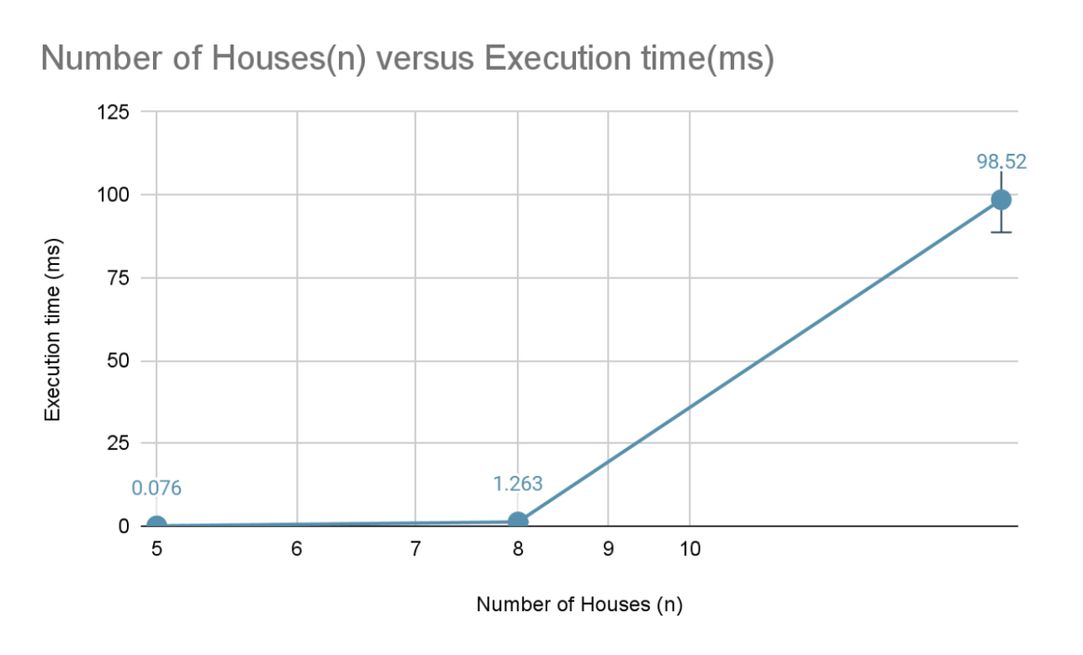
EMPIRICAL ANALYSIS BASED ON OUTPUT AND GRAPH
5 Houses:
Total routes considered: 166
Execution time: 0.076 milliseconds
8 Houses:
Total routes considered: 3,593
Execution time: 1.263 milliseconds
15 Houses:
Total routes considered: 1,720,336
Execution time: 98.520 milliseconds
aligning with the theoretical time complexity of O(n^2 . 2^n) as shown in graph
02 - WEBSITE
03 - SOCIAL MEDIA

Slide 24
STRENGTHS
WEAKNESESS
Optimal Solution for Small to Medium-sized Instances: guarantees of finding the optimal solution for the problem, making it suitable for small to medium-sized instances where other heuristic or approximate methods may fail.
High Space Complexity: The memoization table requires O(n . 2^n) space, which can be prohibitive for large instances, leading to high memory consumption.
Efficient for Dense Graphs: efficiently handles dense graphs by considering all possible routes and memoizing results to avoid redundant calculations
Exponential Time Complexity for Large Instances: The time complexity of O(n^2 . 2^n) grows exponentially with the number of houses, making the algorithm impractical for large instances.

Slide 25
SUMMARY

Slide 26
SUMMARY REPORT
The Held-Karp algorithm is a powerful dynamic programming approach for solving the TSP,
offering optimal solutions for small to medium-sized instances and efficiently handling dense graphs.
However, its high space and exponential time complexity make it less suitable for large instances, highlighting the trade-offs inherent in dynamic programming approaches.
The algorithm's empirical results align with theoretical expectations, confirming its correctness and demonstrating its feasibility for moderately sized problems.

Slide 27
THANK YOU

